Slide 1
Collage Attendance Management System
By
Krish J. Rana
Vishal D. Valand
Virendra V. Rohit

Slide 2
Introduction
This Web Application will contain three different types of login forms: 1. Admin, 2. Lecturer, 3.Students.
Admin has authority to manage student, lecturers and subject. Admin can add, remove, modify, search student, lecturer and Subject. Only admin has full access to the databases.
Lecturer has access to attendance module of a system. Lecturer can fill attendance of student and also can see the attendance of a student.
Student can only see their attendance they do not have other permission.

Slide 3
Login:
User can login according to their profession. Admin and lecturers have their login id and password and student can login into system using enrolment number and Password. One for admin login, second for lecturer login and third for student login.
Attendance:
Attendance will be taken for all department separately. There for students are divided according to their department. When attendance of students are submitted at that time name of lecturer and time will be saved in database.
Lecturer:
Lecturer has given some subjects. And lecturer may allocated for one or more department. Lecturer can have more than one subject.

Slide 4
Advantage of this system:
System will help to maintain attendance record and make task of taking attendance easy.
Teacher does not has to worry about creating attendance report monthly.
Students can see their attendance record whenever required.

Slide 5
Data Set

Slide 6
Entity Set:
Student
Lecturer
Subject
Branch
Attendance
Admin

Slide 7
Attributes:
Entity | Attributes
Student | StuRollno, StuName, Gender, Email_ID, Contact_no, Sem, Year, Password
Lecturer | Lect_ID, Lect_Name, Contact_no, Email_ID, Password
Subject | SubID, SubName
Attendance | Att_ID, Date, Time, Status
Branch | Branch_ID, BranchName
Admin | Admin_ID, AdminName, Contact_no, Email_ID, Password

Slide 8
Association among entity set
 | Student | Lecturer | Subject | Attendance | Branch | Admin
Student | X | X | X | ✓ | ✓ | X
Lecturer | X | X | ✓ | ✓ | ✓ | X
Subject | X | ✓ | X | ✓ | ✓ | X
Attendance | ✓ | ✓ | ✓ | X | X | X
Branch | ✓ | ✓ | ✓ | X | X | X
Admin | X | X | X | X | X | X

Slide 9
Mapping Cardinality
Entity Set | Relationship Set | Mapping Cardinality
Student – Attendance | Stu_Att | One to many
Student – Branch | Stu_Br | Many to One
Lecturer – Subject | Lect_Sub | Many to Many
Lecturer – Branch | Lect_Br | One to Many
Subject – Branch | Sub_Br | Many to Many
Subject – Attendance | Sub_Att | One to Many
Lecturer - Attendance | Lect_Att | One to Many

Slide 10
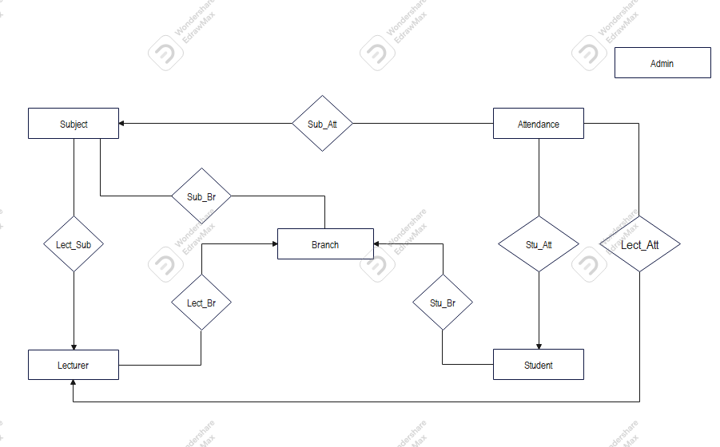
ER Diagram

Slide 11
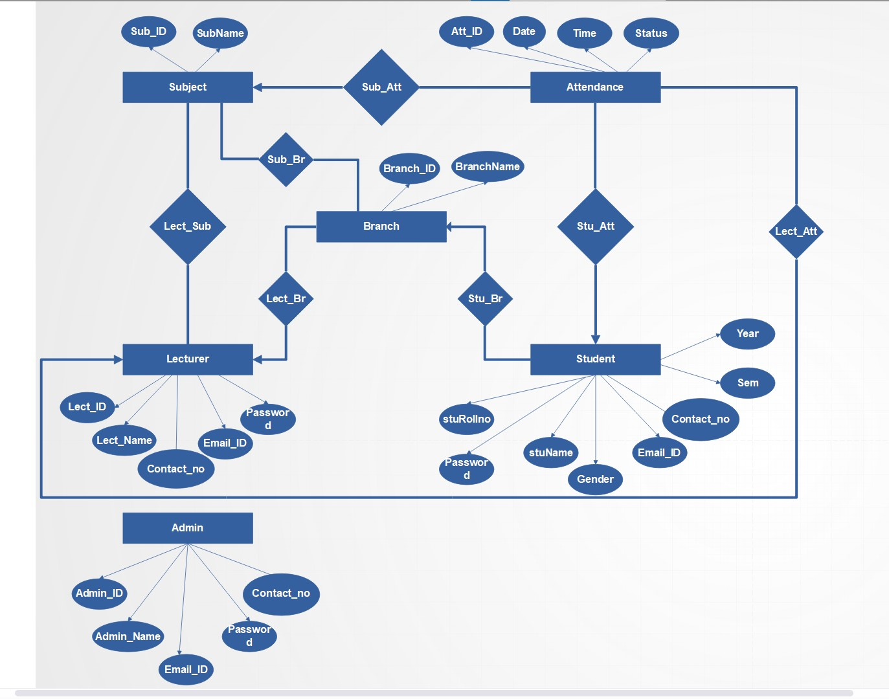
ER Diagram with Descriptive Attributes

Slide 12
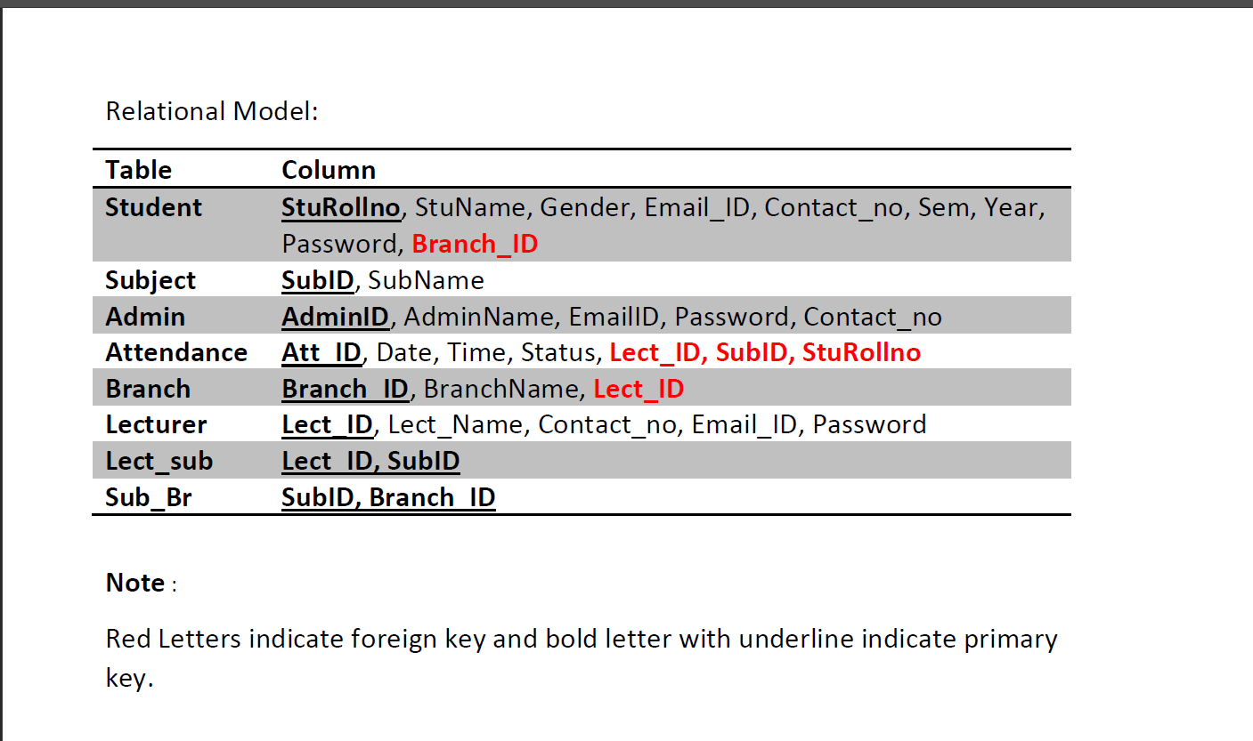
Relational Model

Slide 13
Data Dictionary

Slide 14
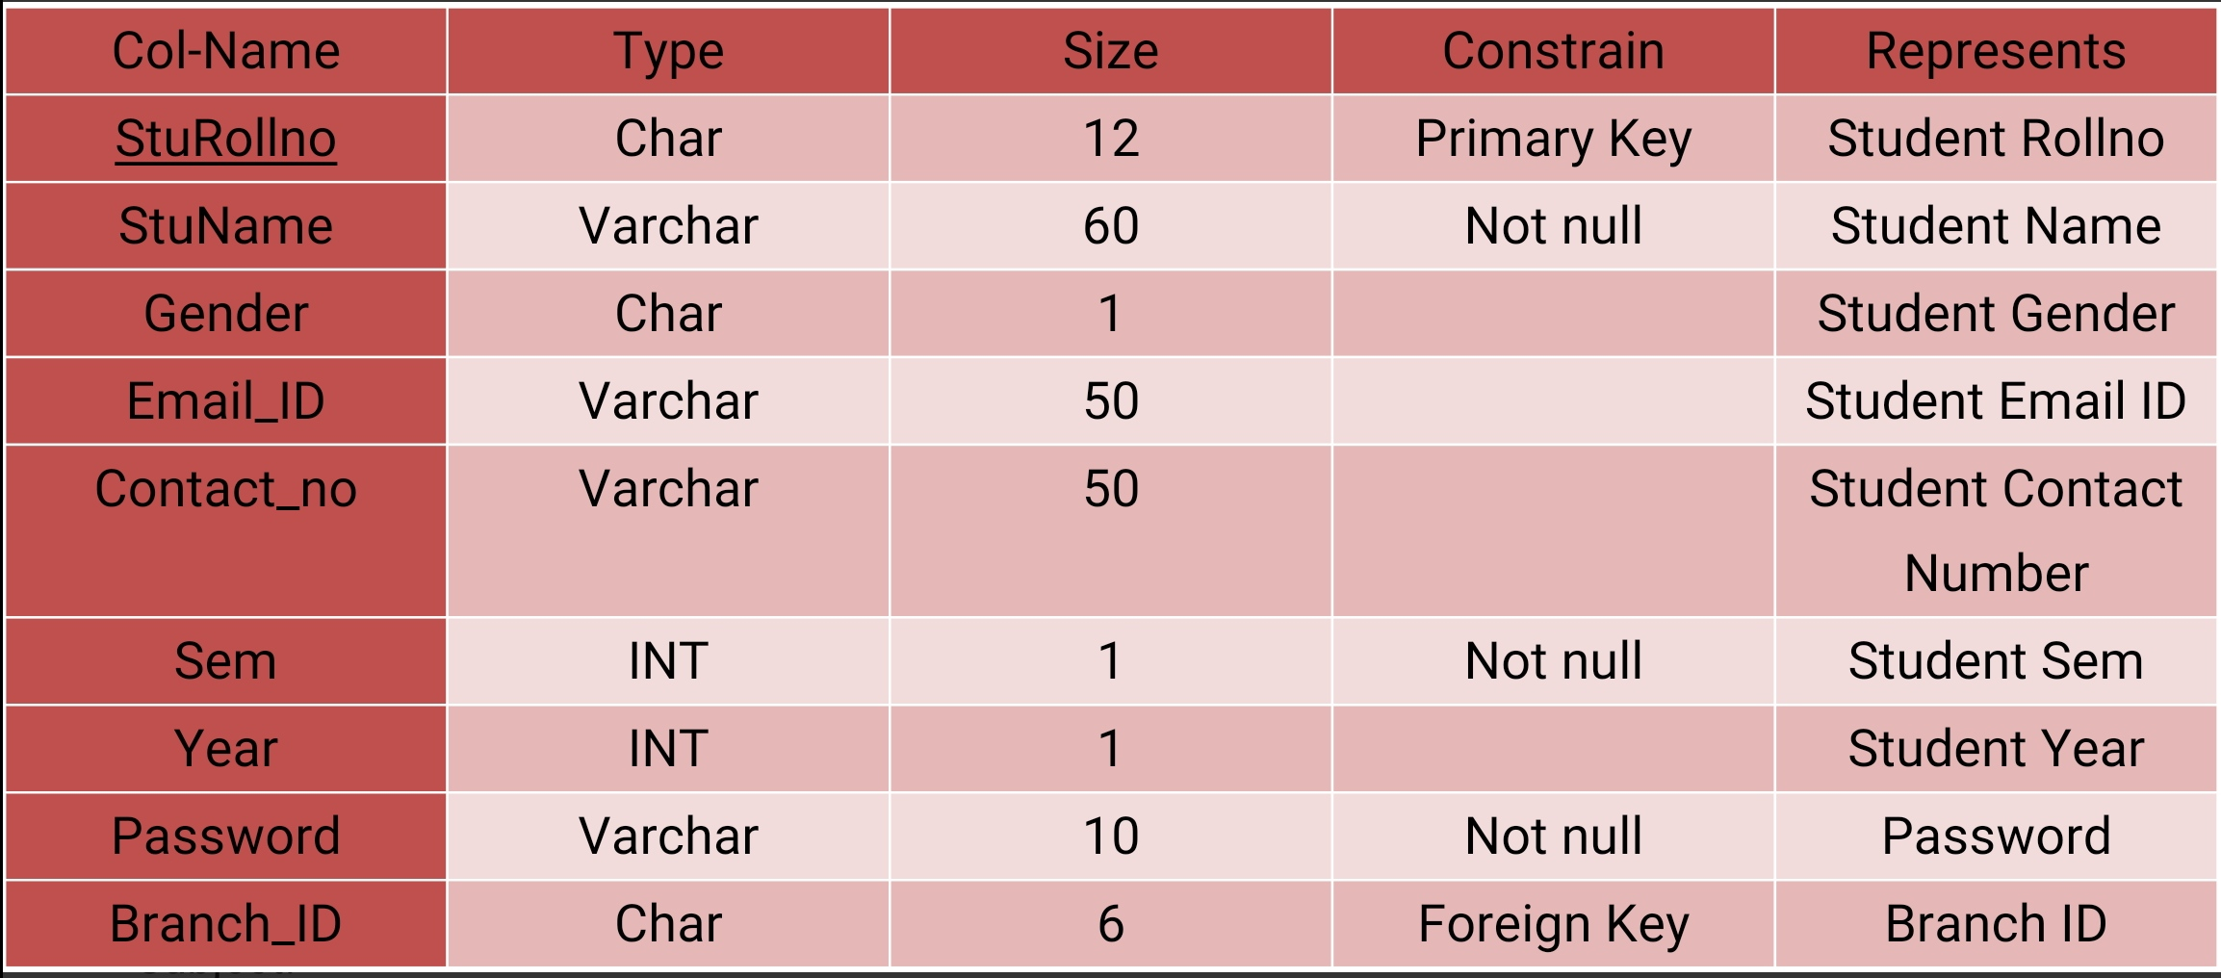
Student

Slide 15
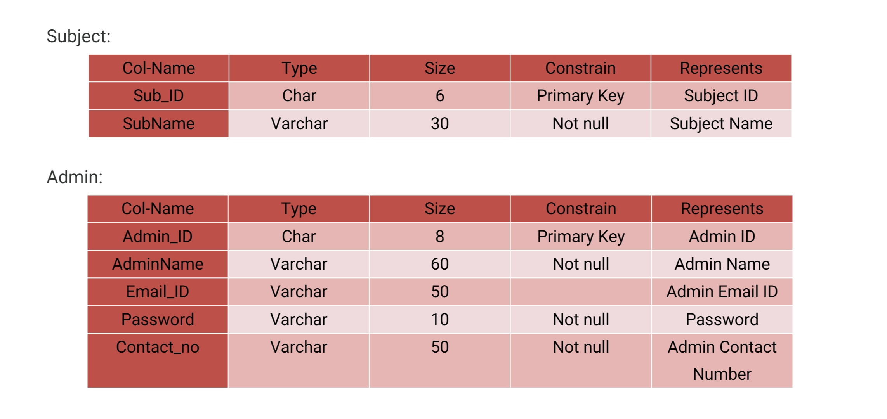
Subject and Admin

Slide 16
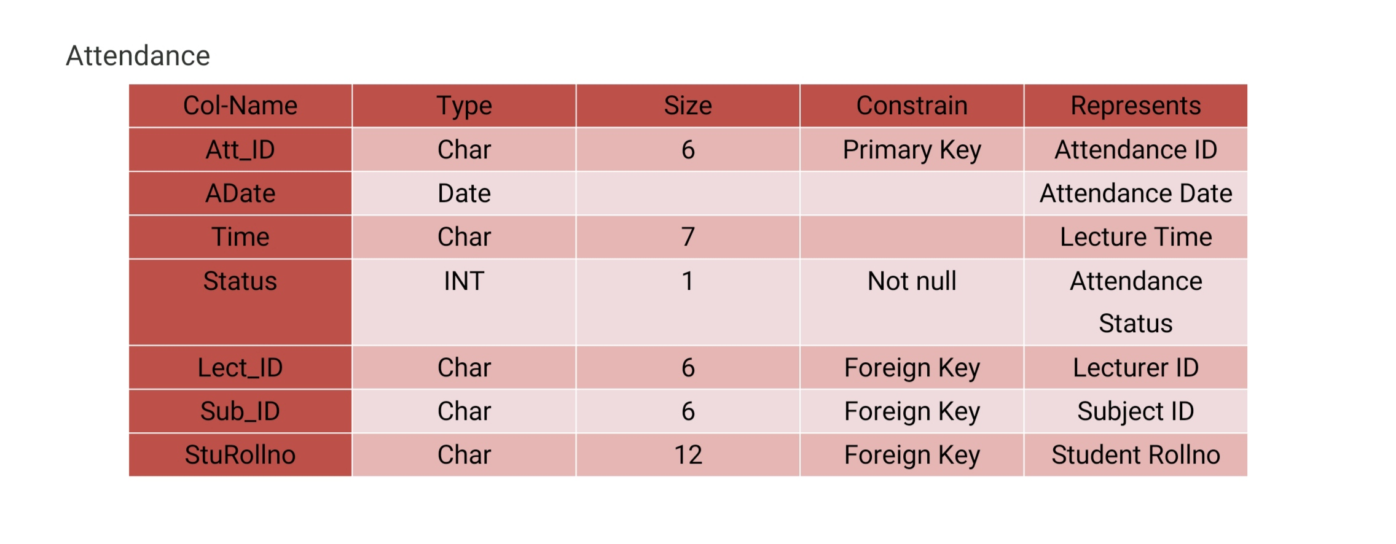
Attendance

Slide 17
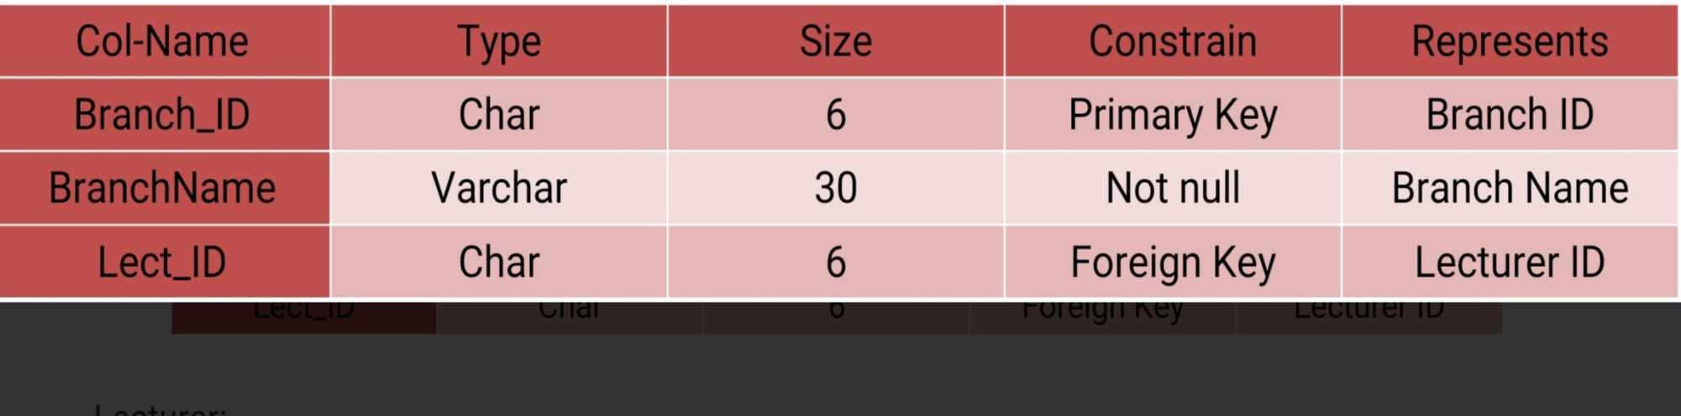
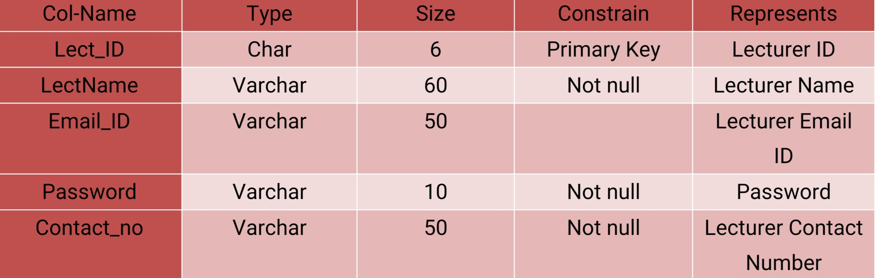
Branch and Lecturer

Slide 18
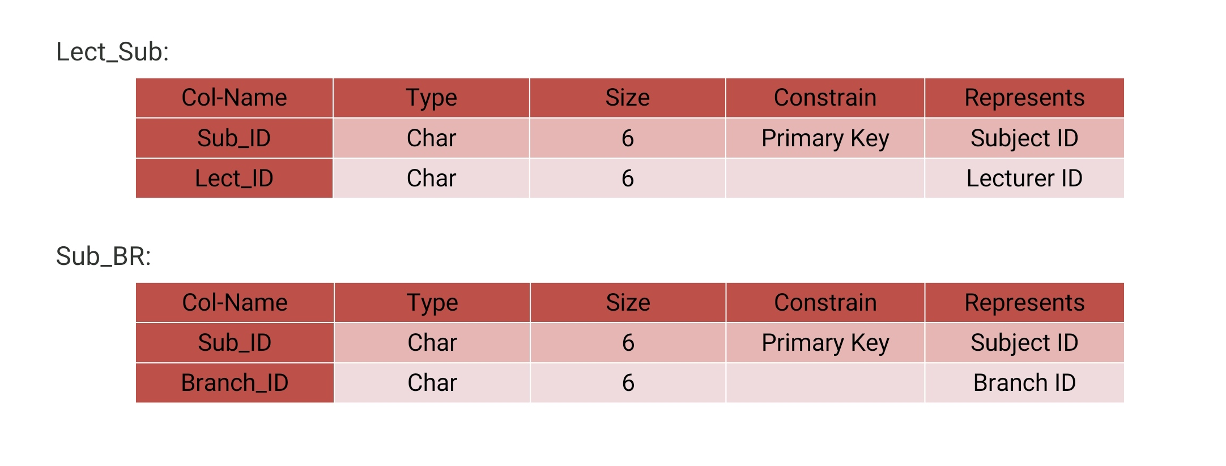
For Lect_Sub and Sub_Br

Slide 19
Data Flow Diagram

Slide 20
High Level Function
Manage Student Data
Manage Subject Data
Manage Attendance Data
Manage Lecturer Data
Manage Branch Data
Manage Admin Data
Manage Login Data

Slide 21
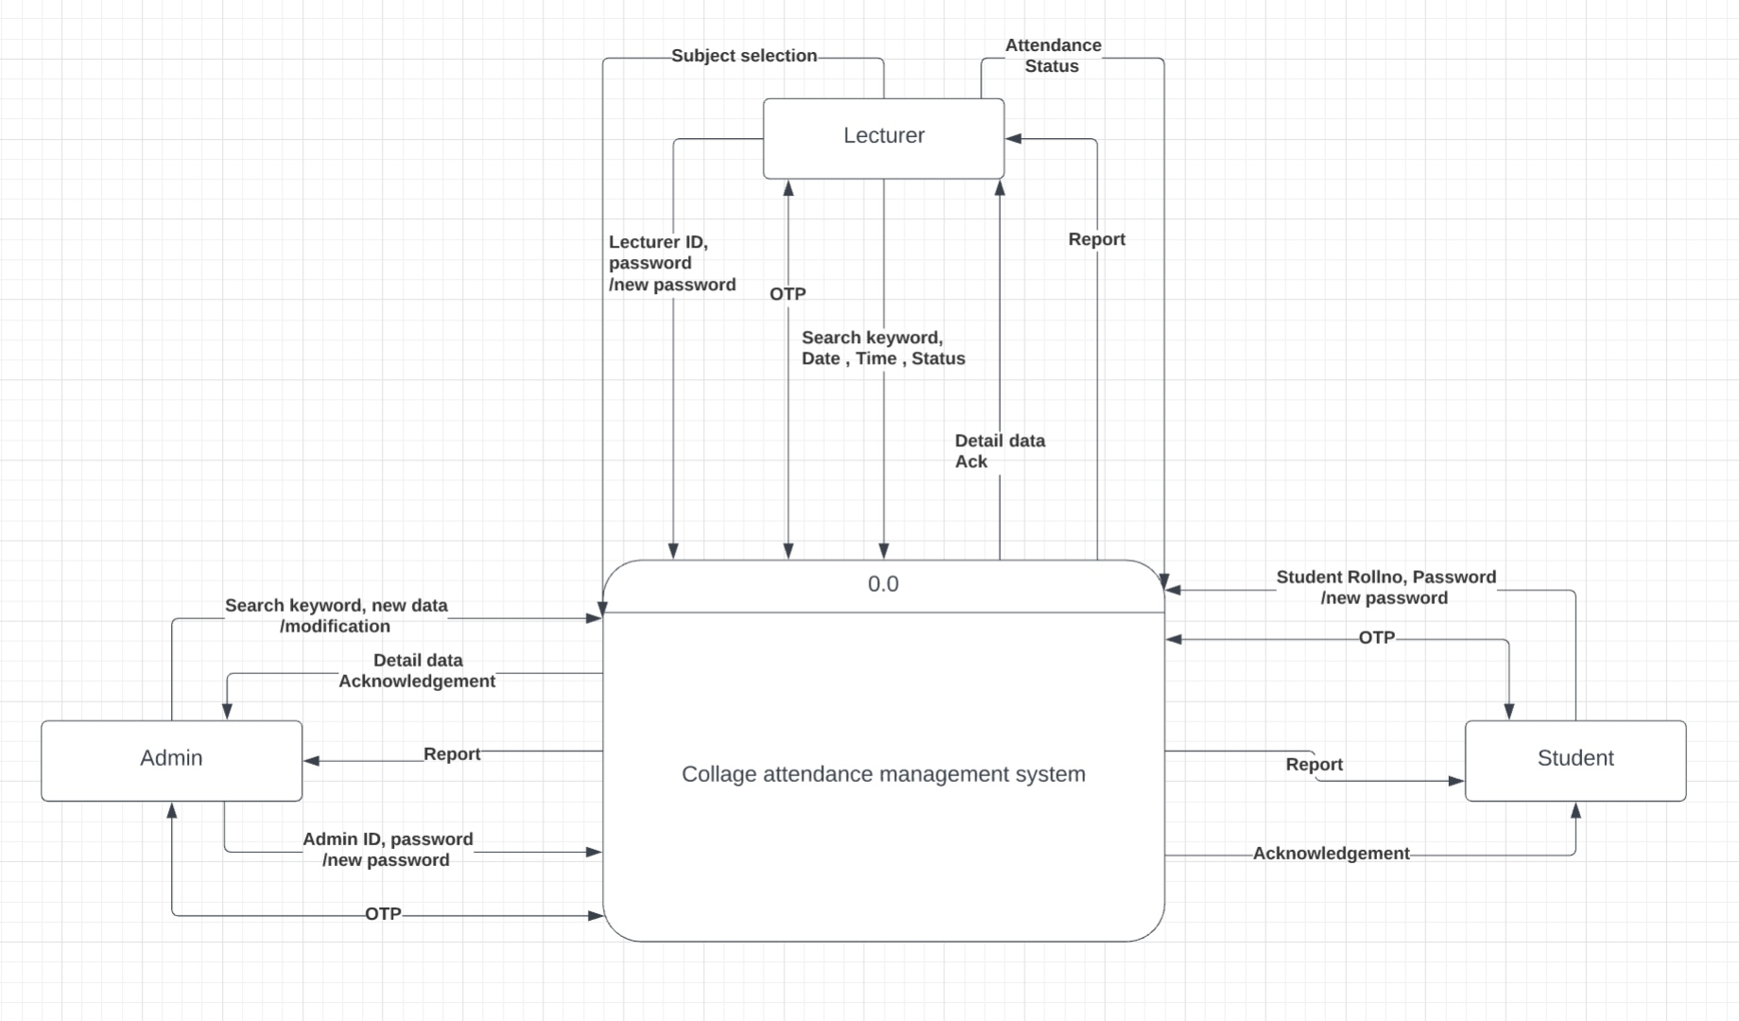
Level 0 Diagram:

Slide 22
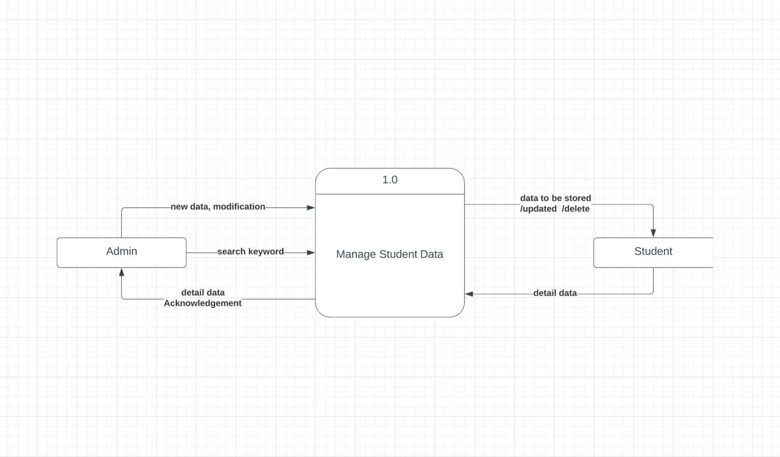
Level 1 : Manage Student Data

Slide 23
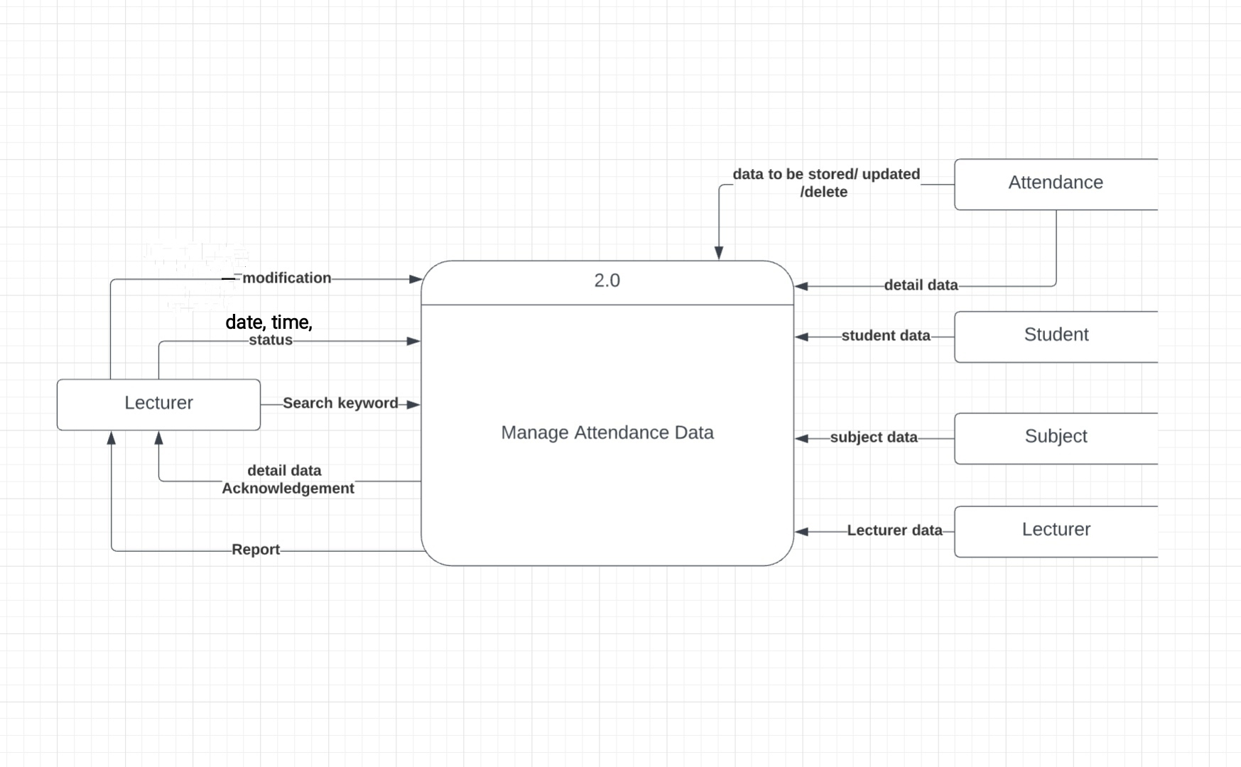
Level 1: Manage Attendance Data

Slide 24
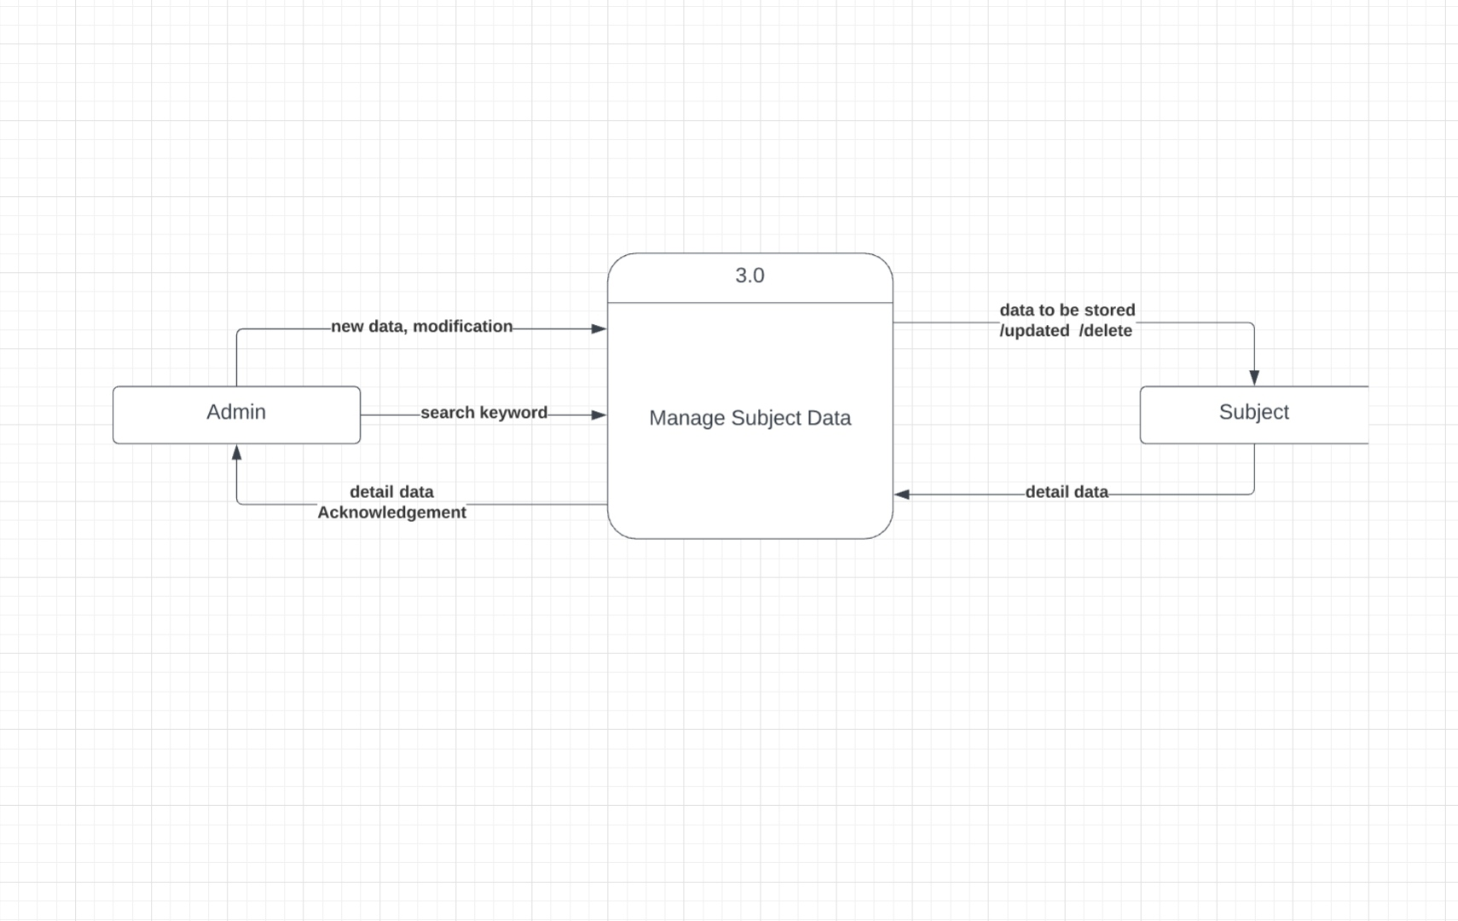
Level 1: Manage Subject Data

Slide 25
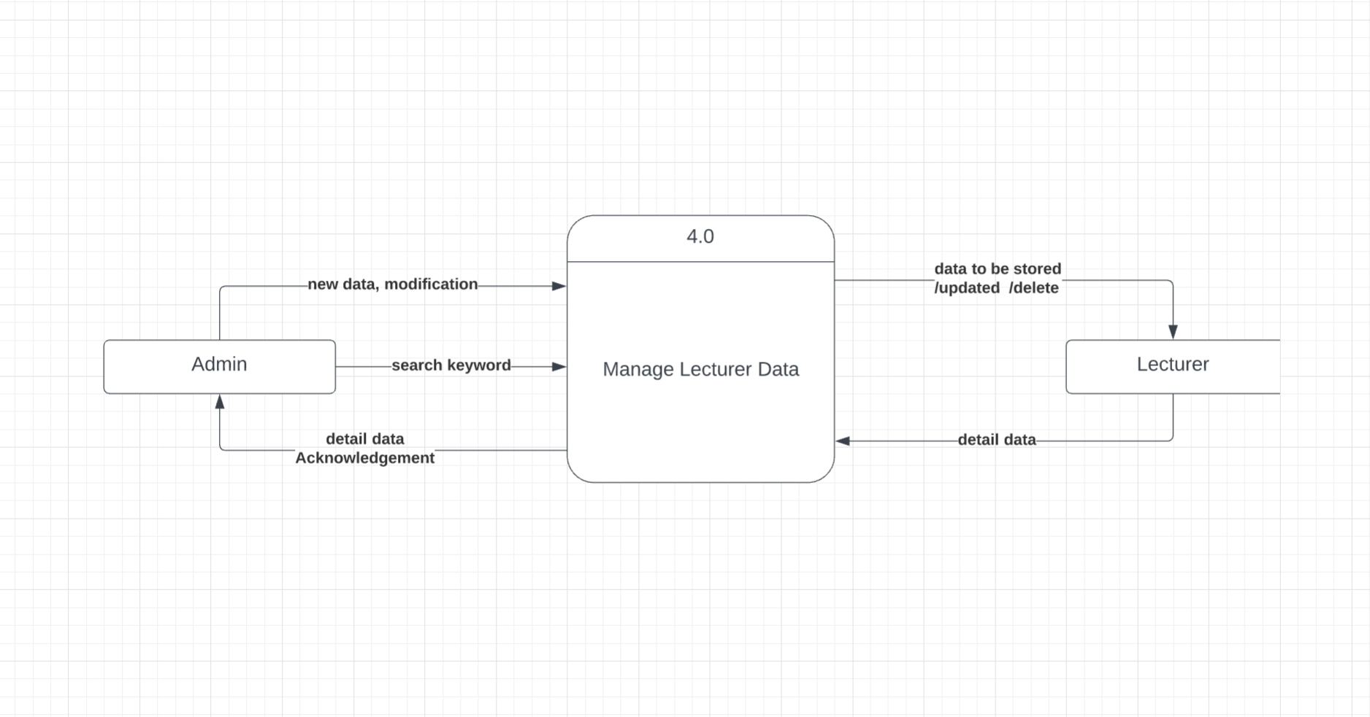
Level 1: Manage Lecturer Data

Slide 26
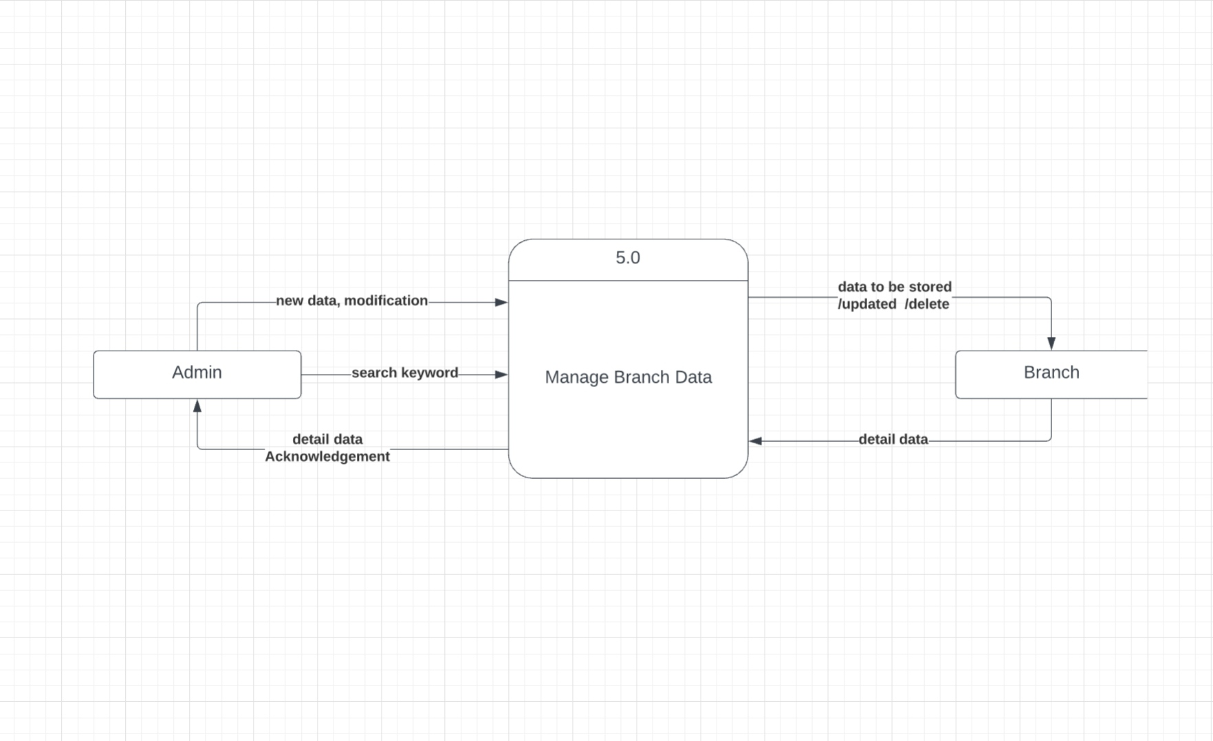
Level 1: Manage Branch Data

Slide 27
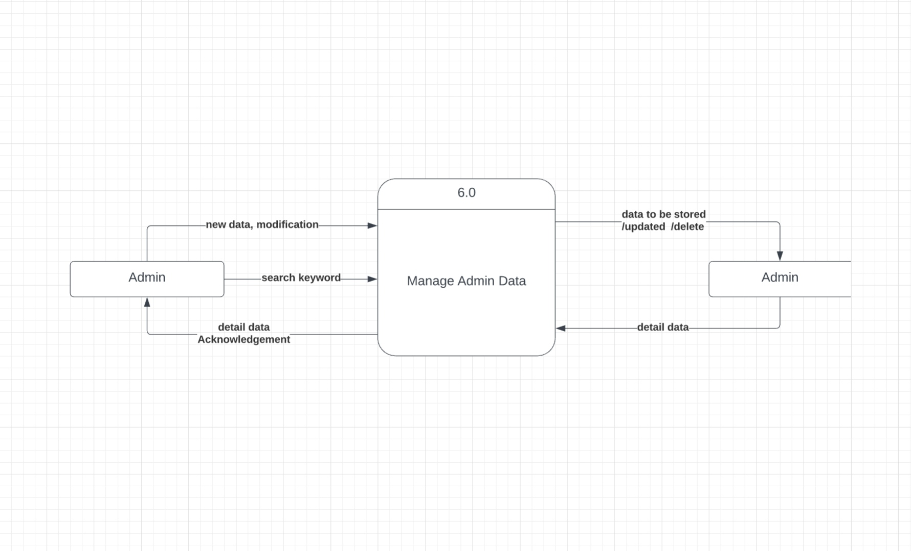
Level 1: Manage Admin Data

Slide 28
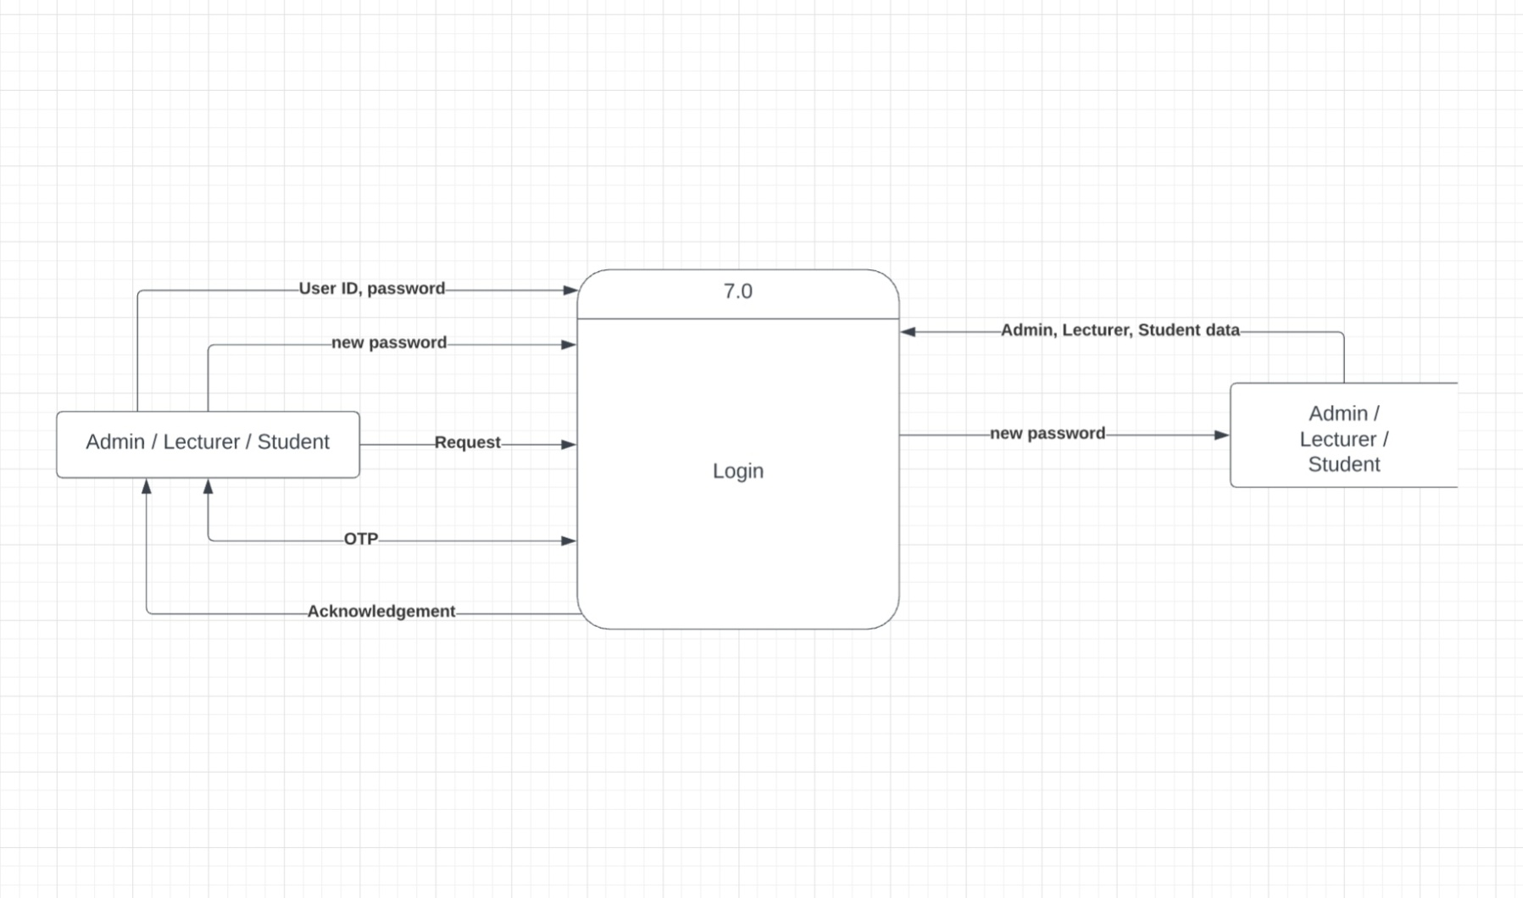
Level 1: Manage Login

Slide 29
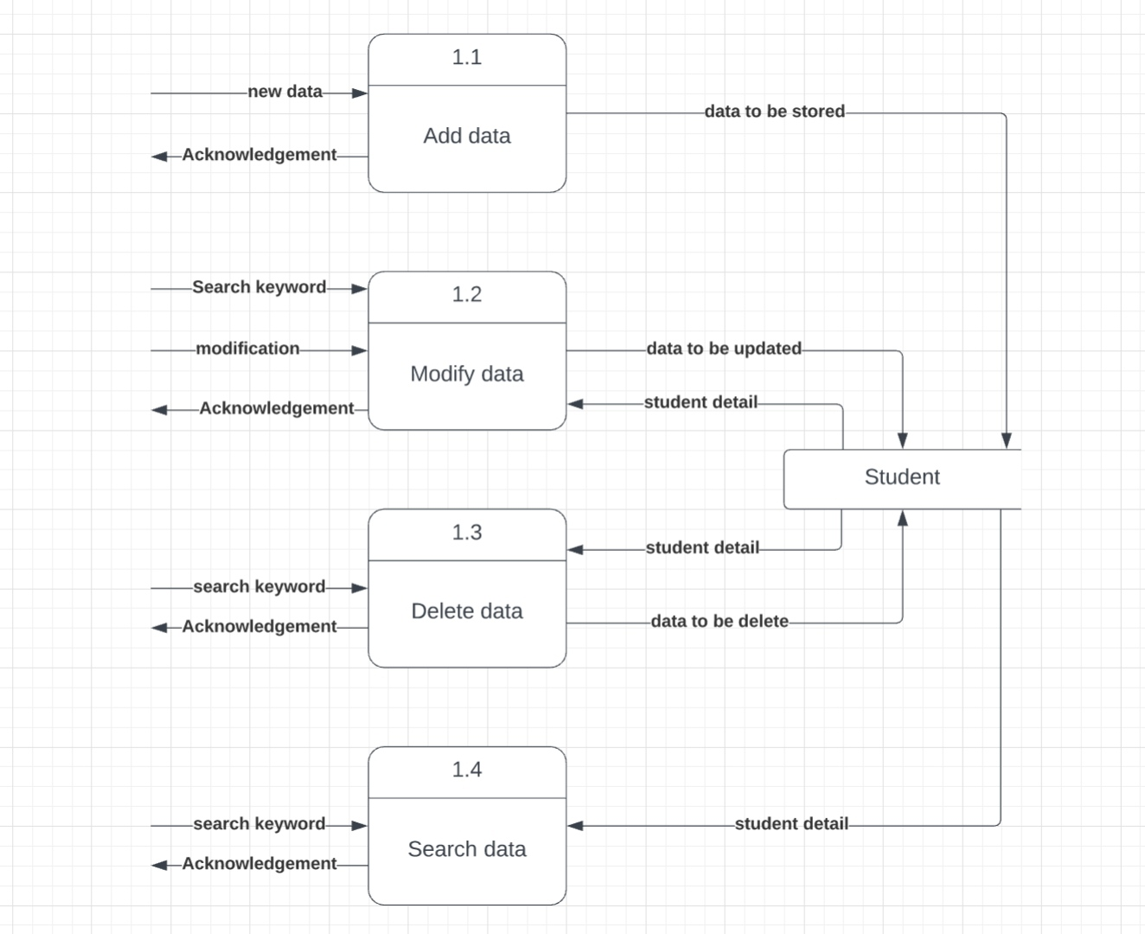
Level 2: Manage Student Data

Slide 30
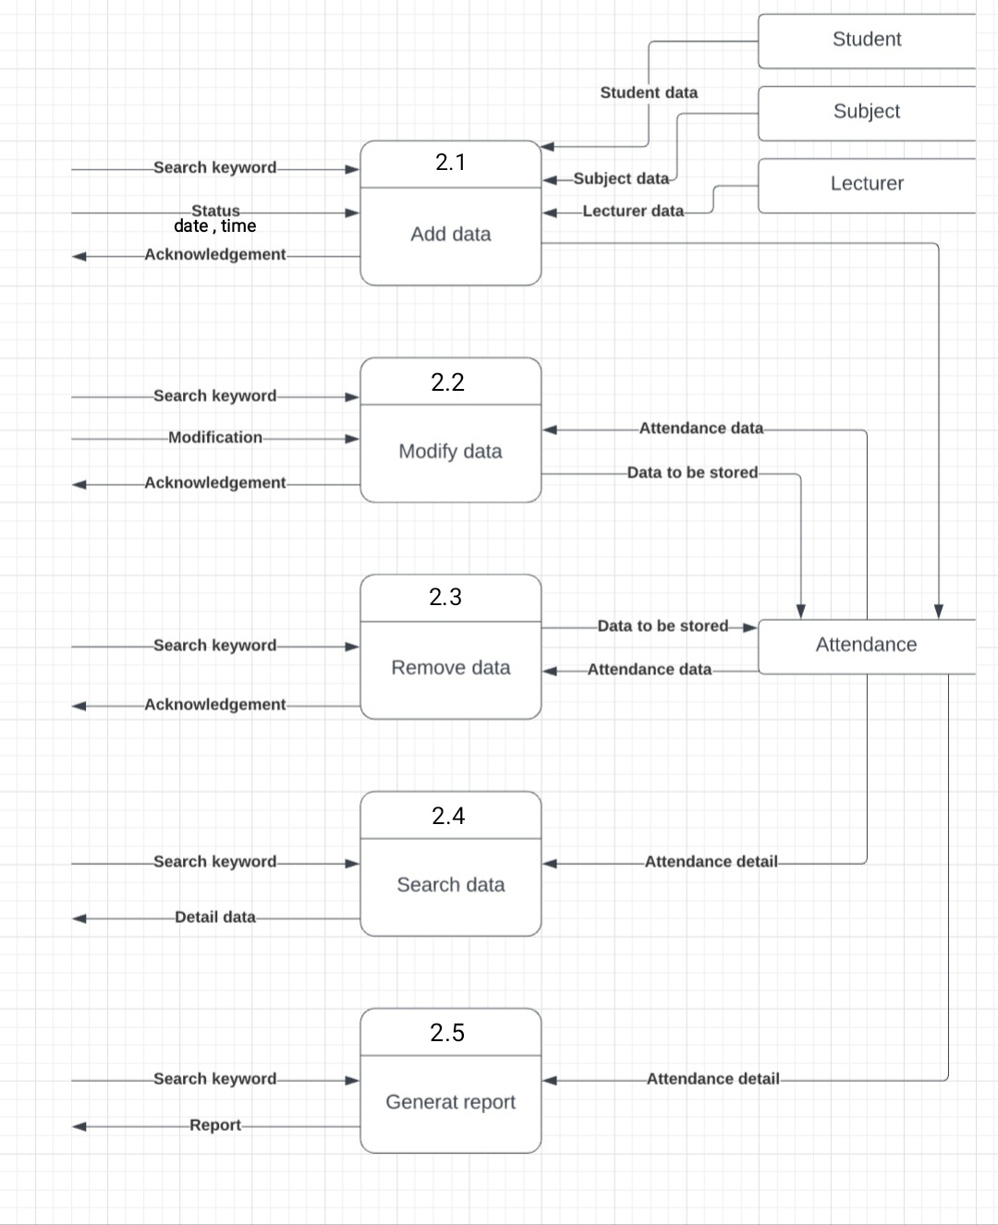
Level 2: Manage Attendance Data

Slide 31
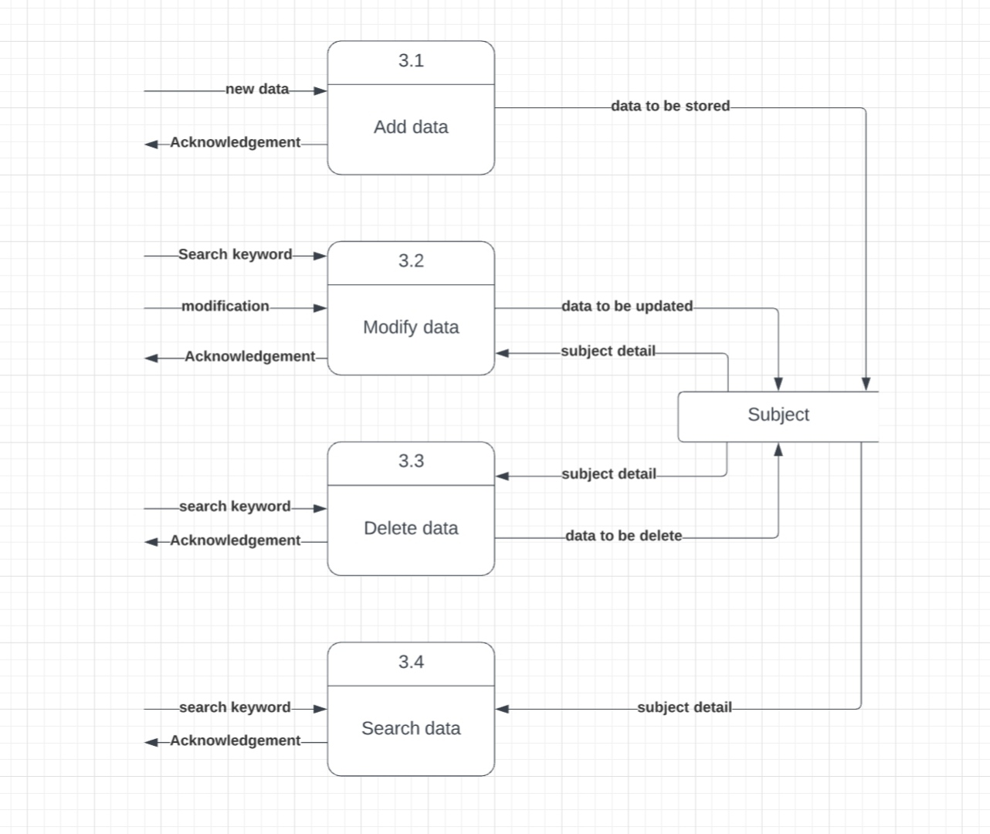
Level 2: Manage Subject Data

Slide 32
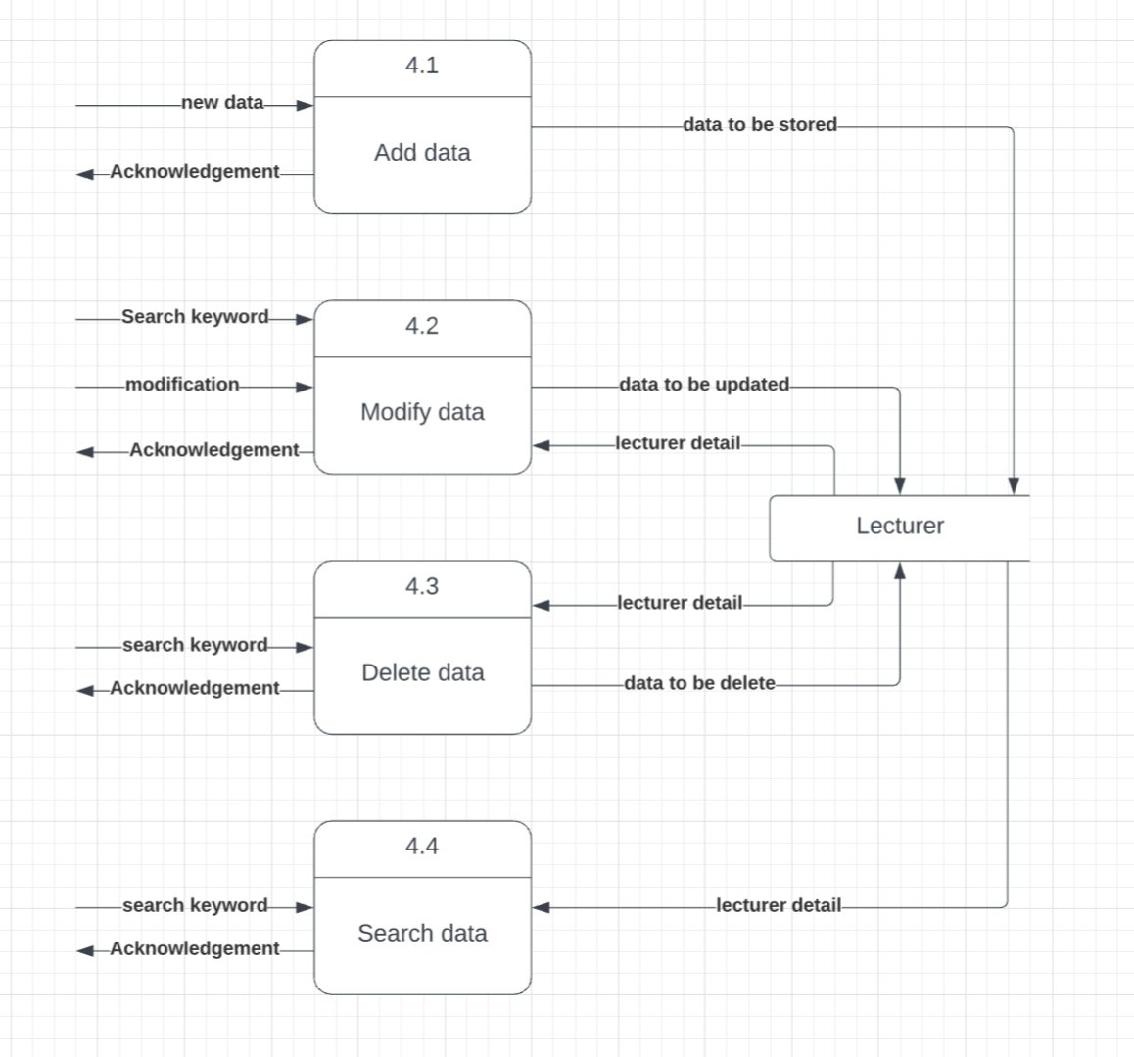
Level 2: Manage Lecturer Data

Slide 33
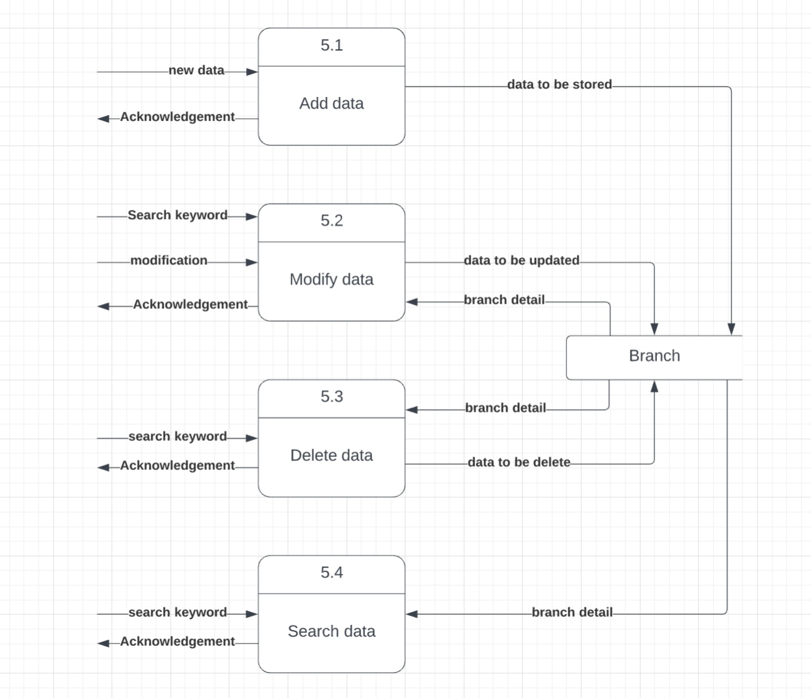
Level 2: Manage Branch Data

Slide 34
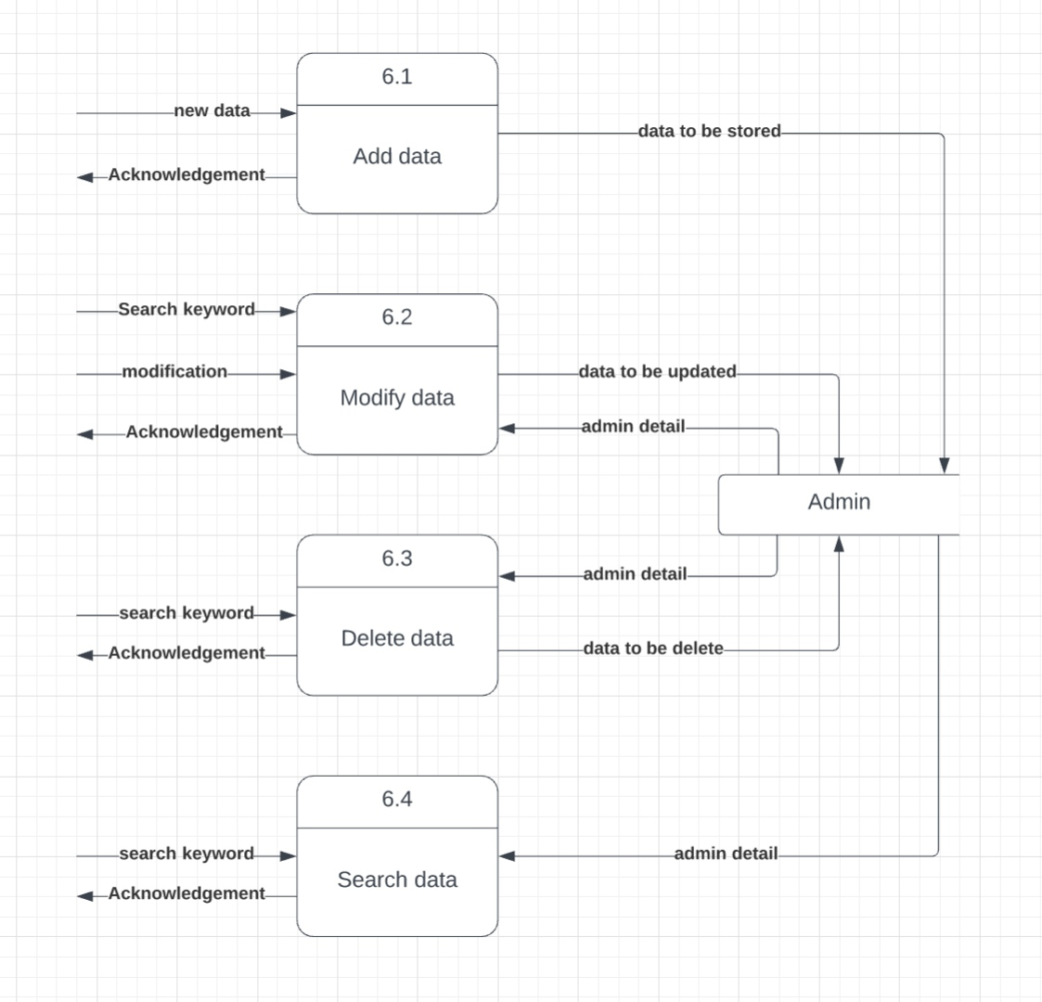
Level 2: Manage Admin Data

Slide 35
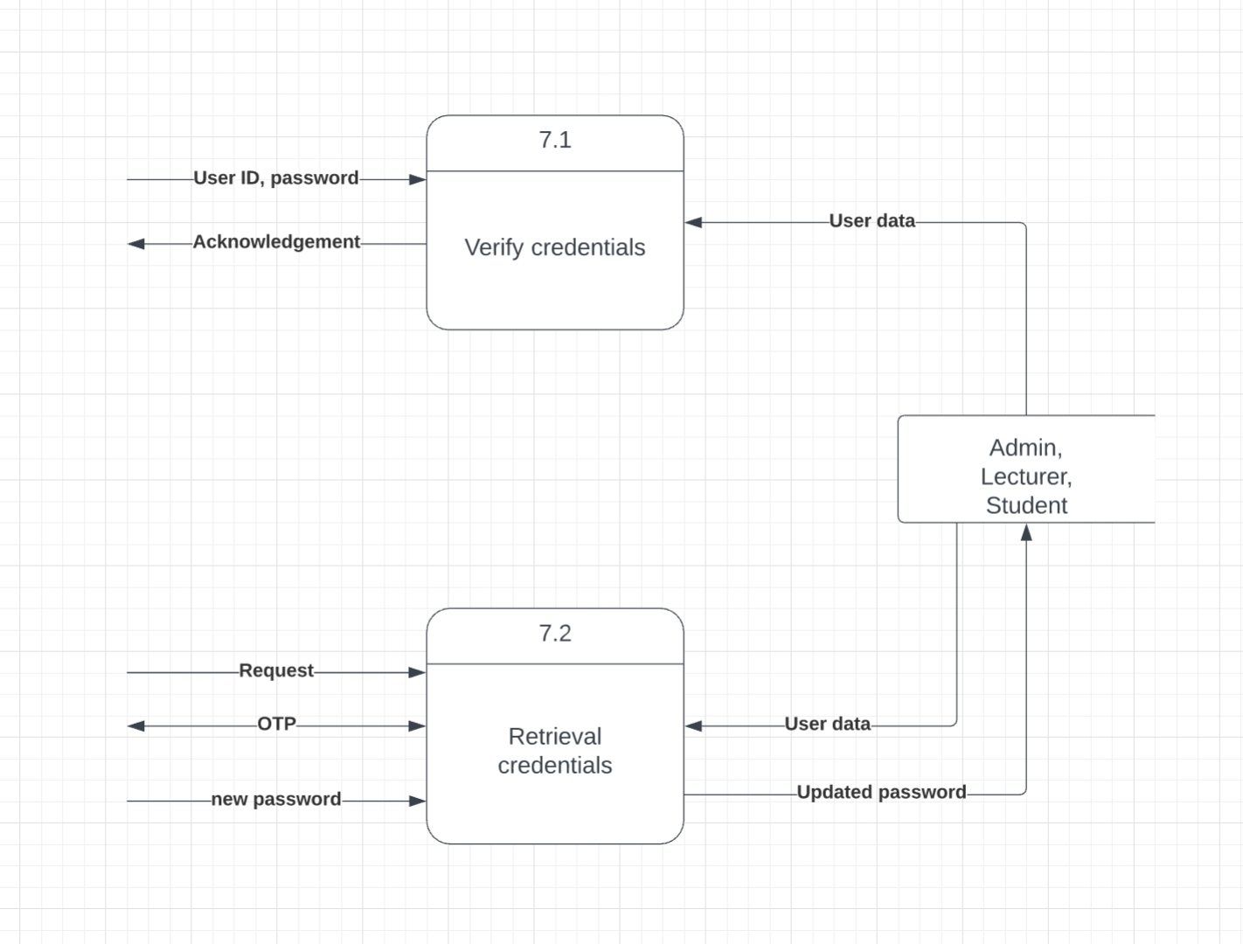
Level 2: Manage Login

Slide 36
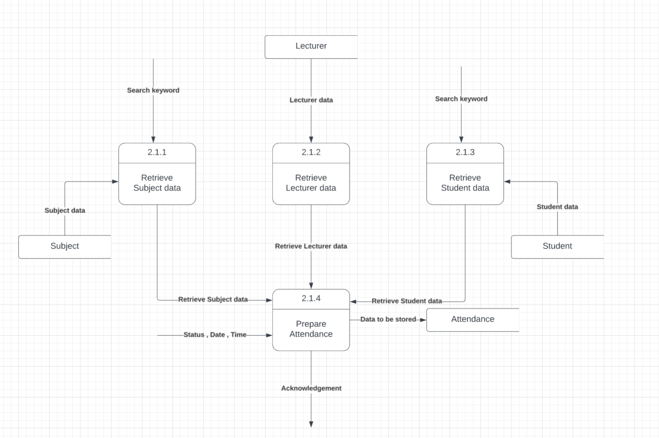
Level 3: Manage Attendance Data

Slide 37
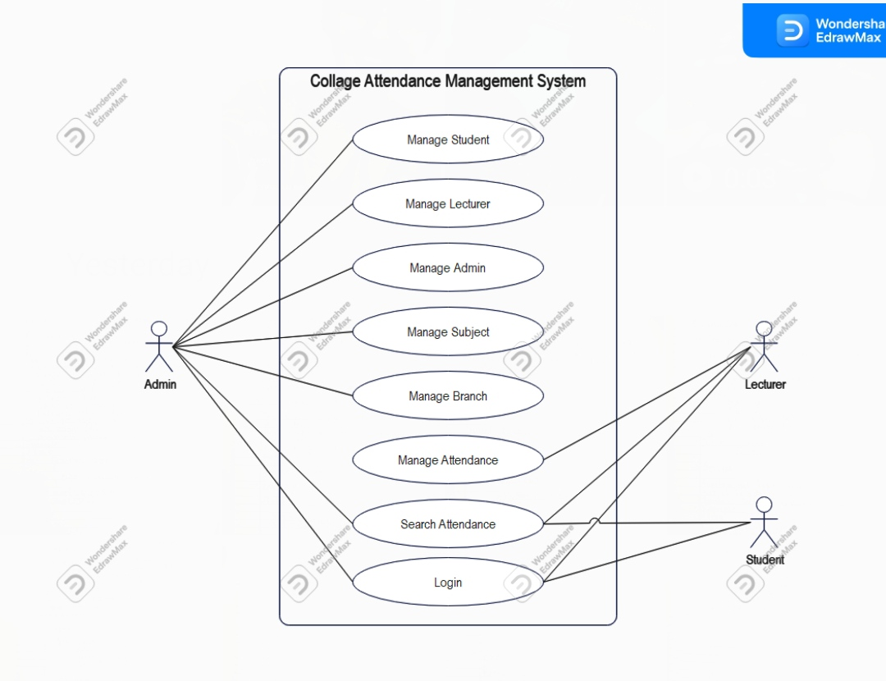
Use Case Diagram

Slide 38

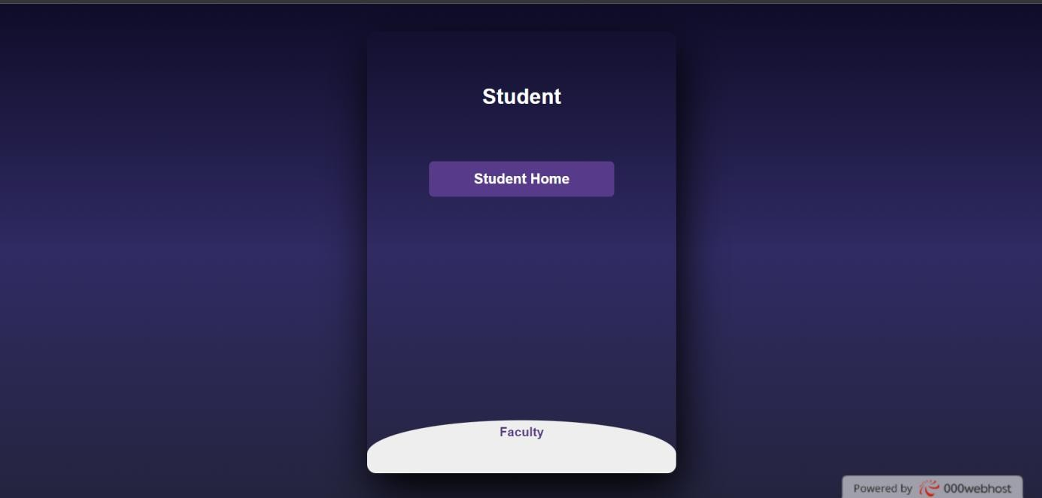
Student Module

Slide 39
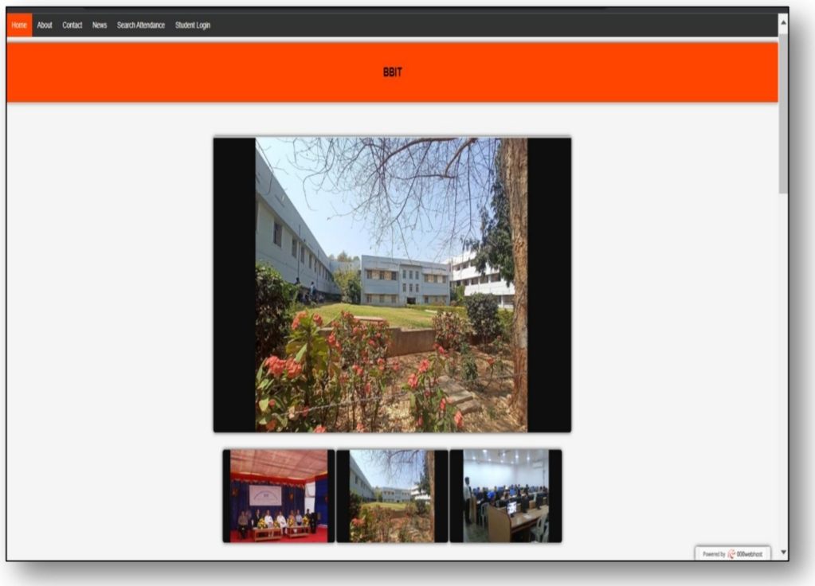

Slide 40
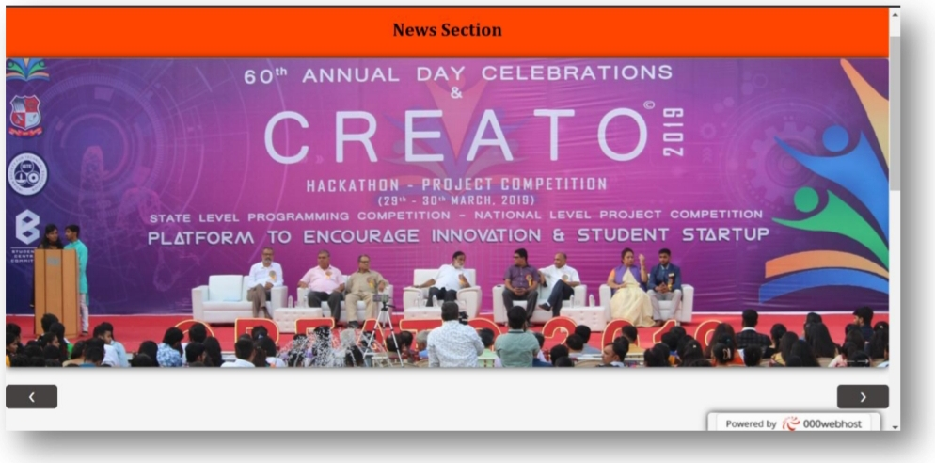

Slide 41
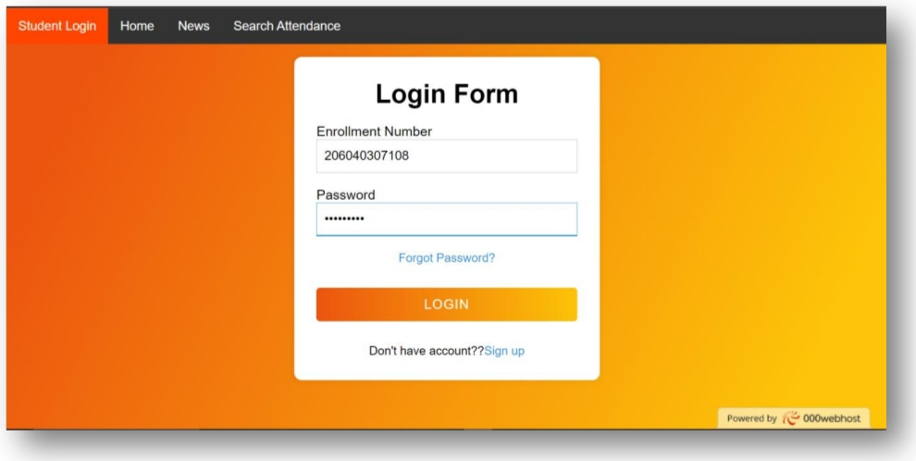

Slide 42
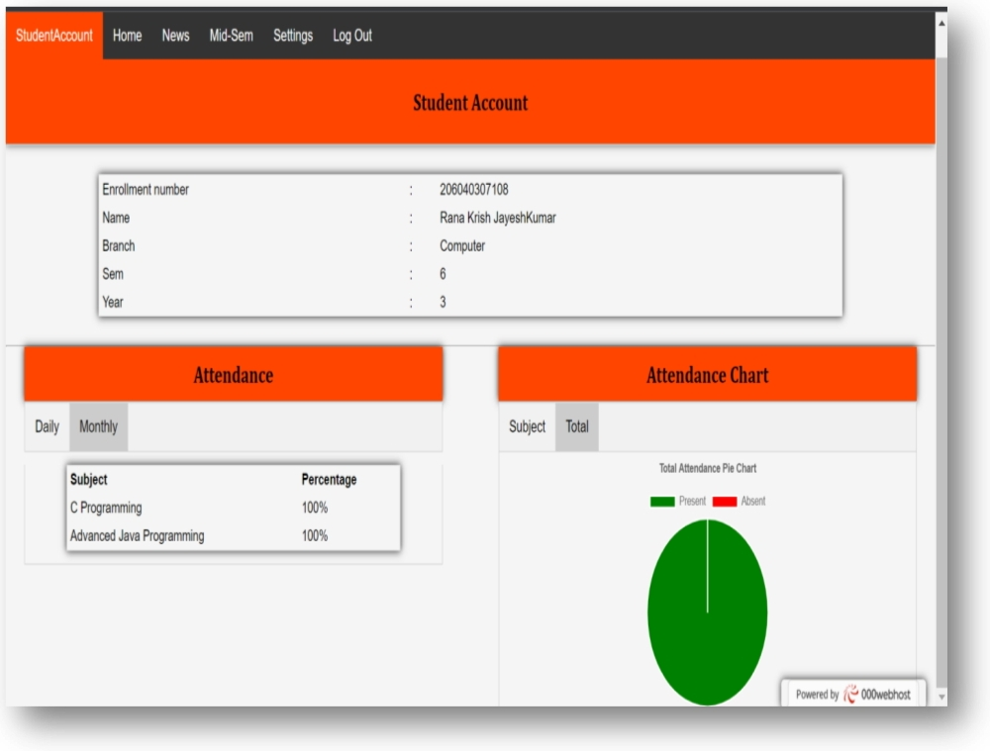

Slide 43
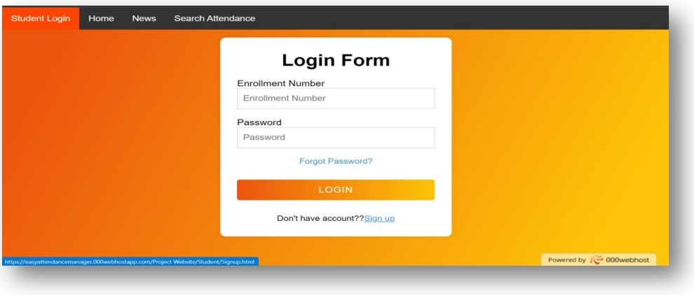

Slide 44
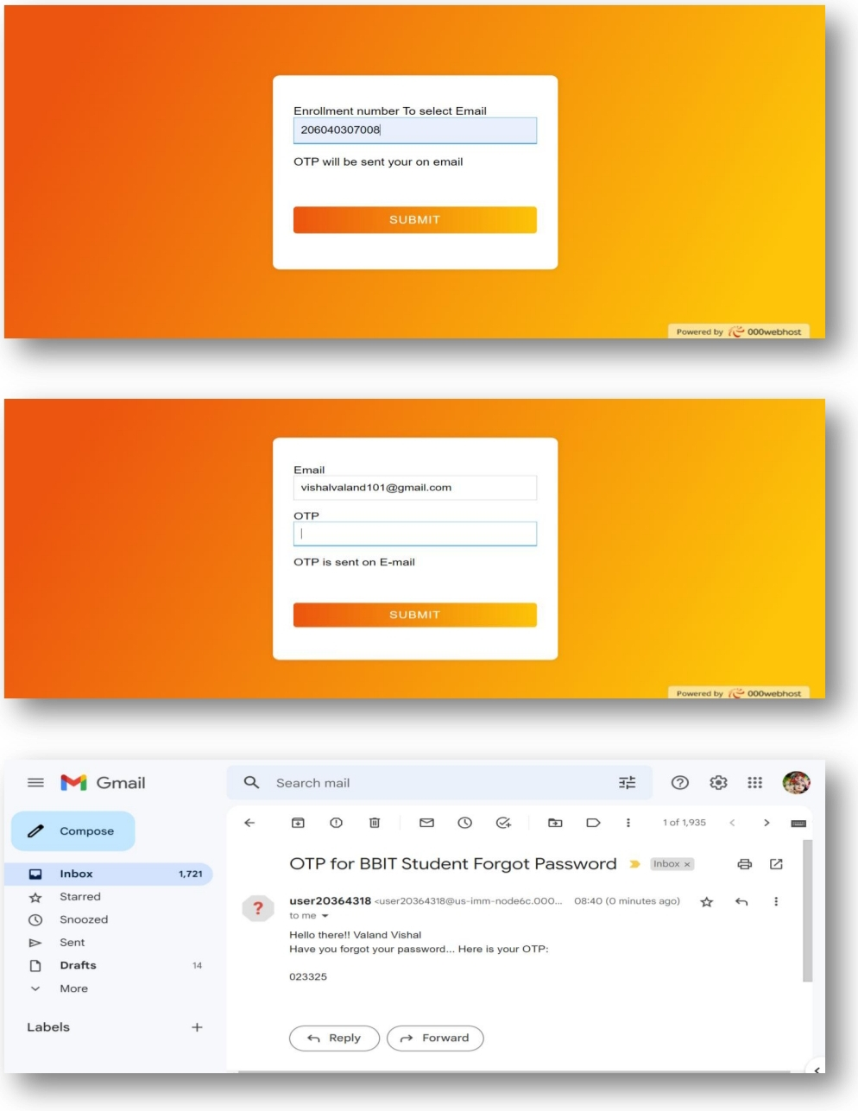

Slide 45
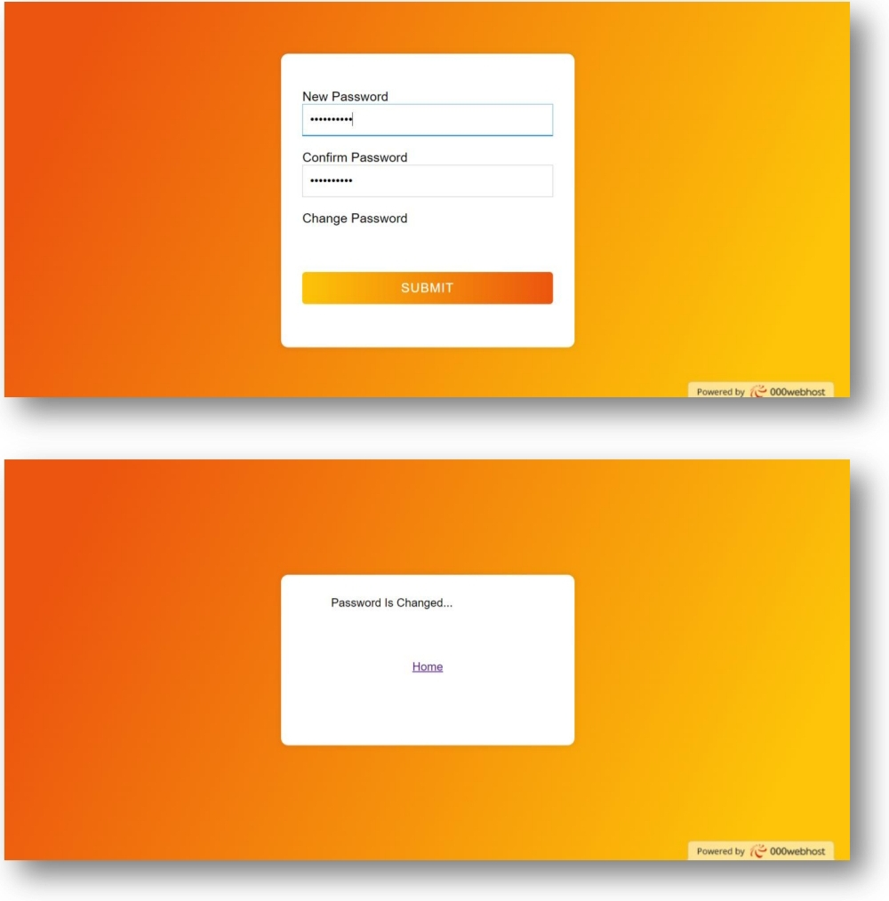

Slide 46
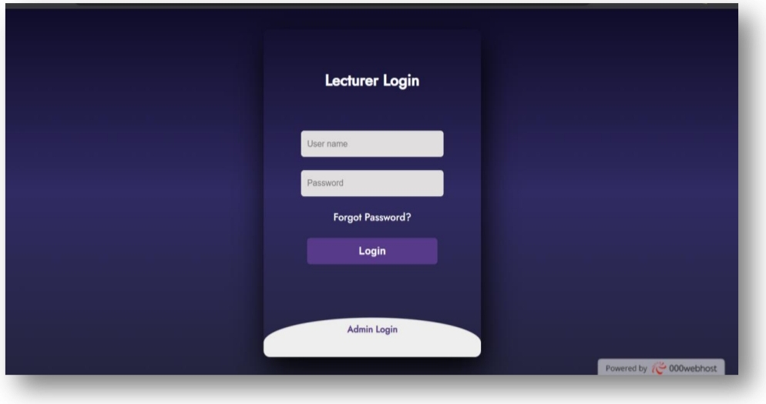
Lecturer Module

Slide 47
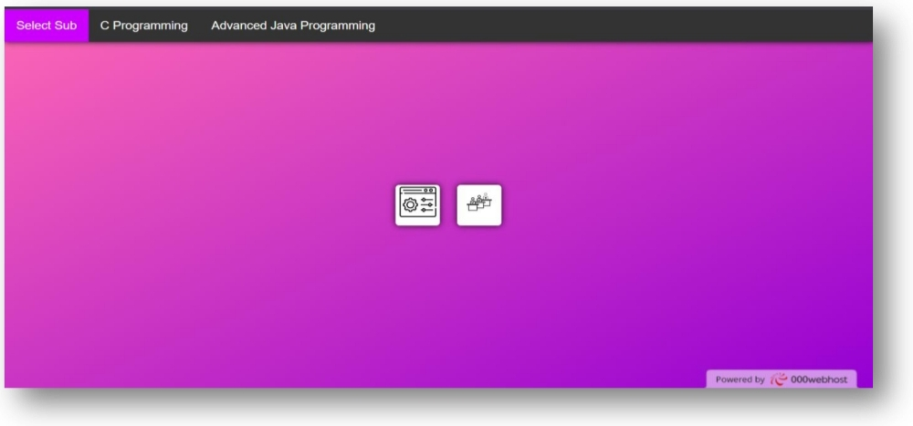

Slide 48
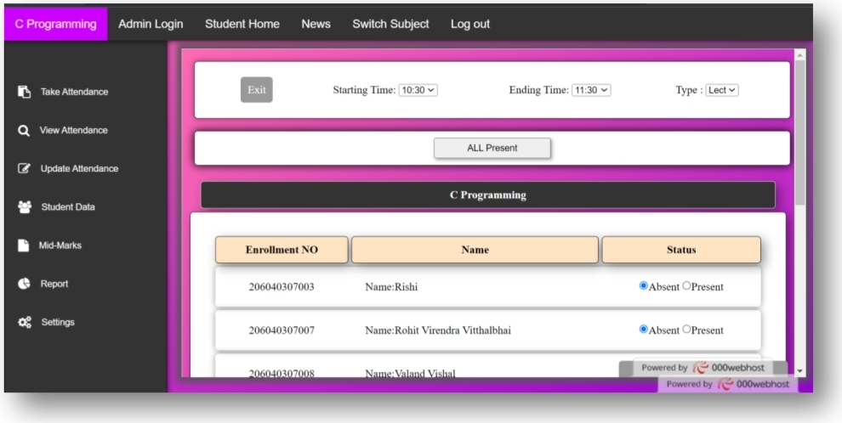

Slide 49
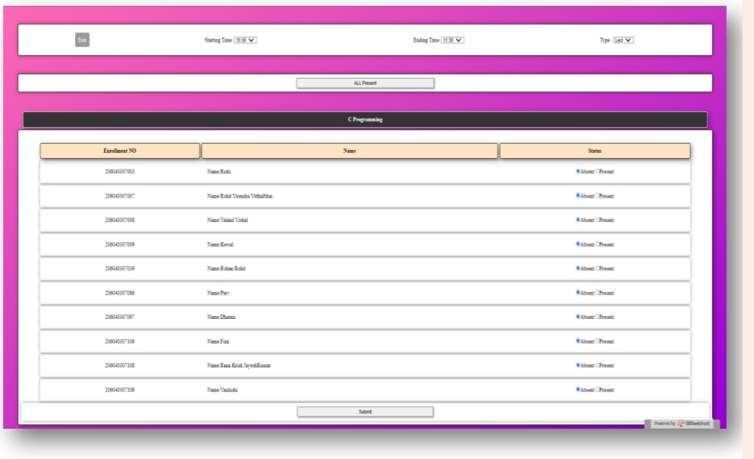

Slide 50
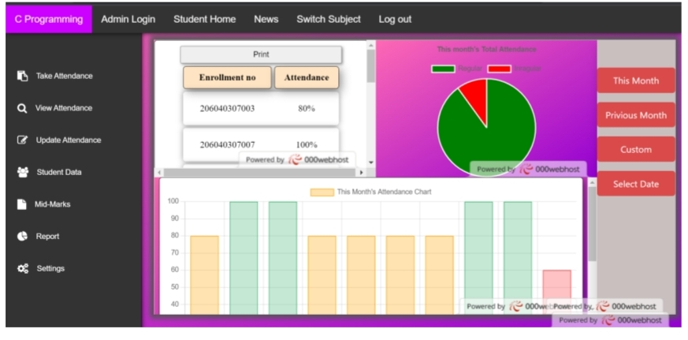

Slide 51
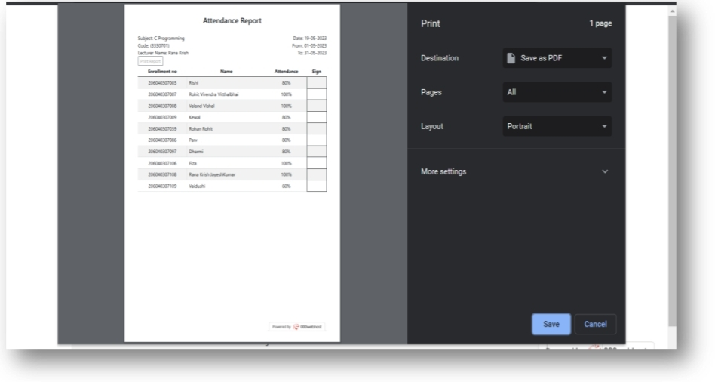

Slide 52
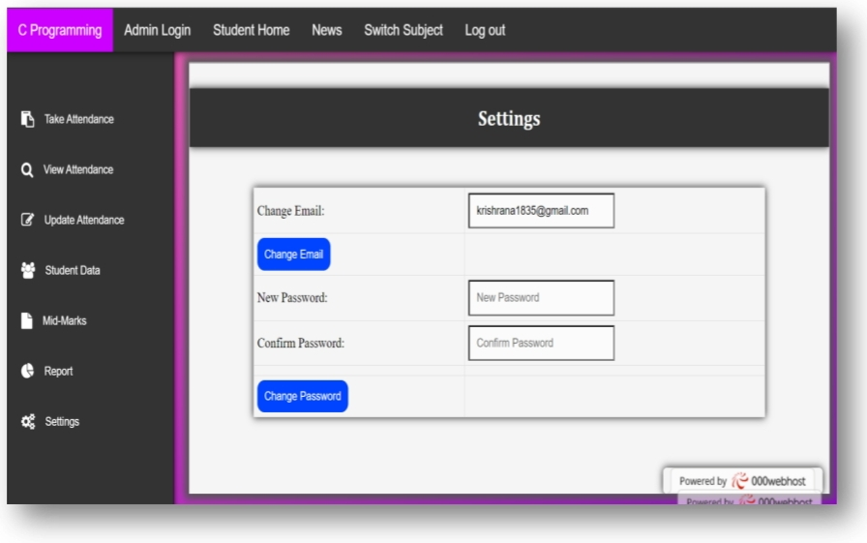

Slide 53
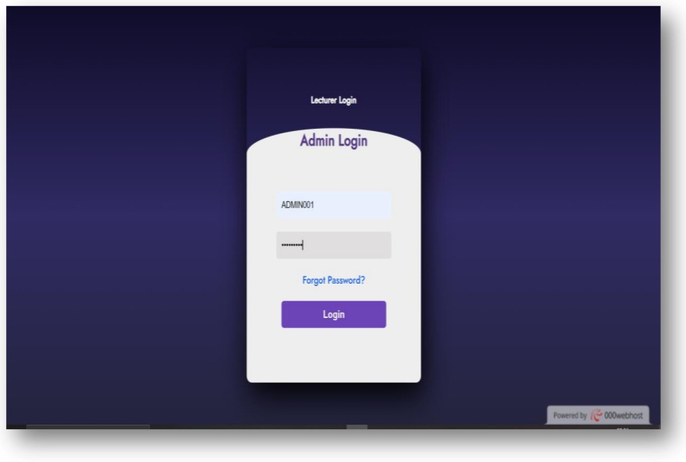
Admin Module

Slide 54
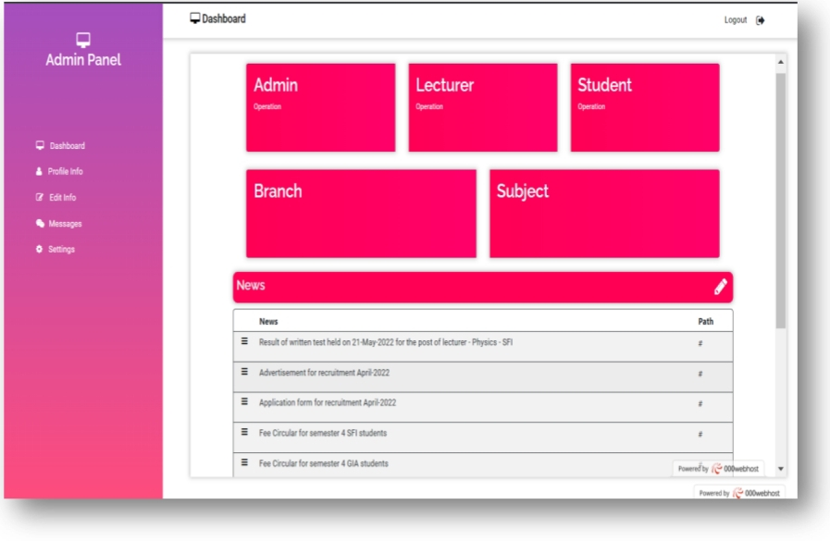

Slide 55
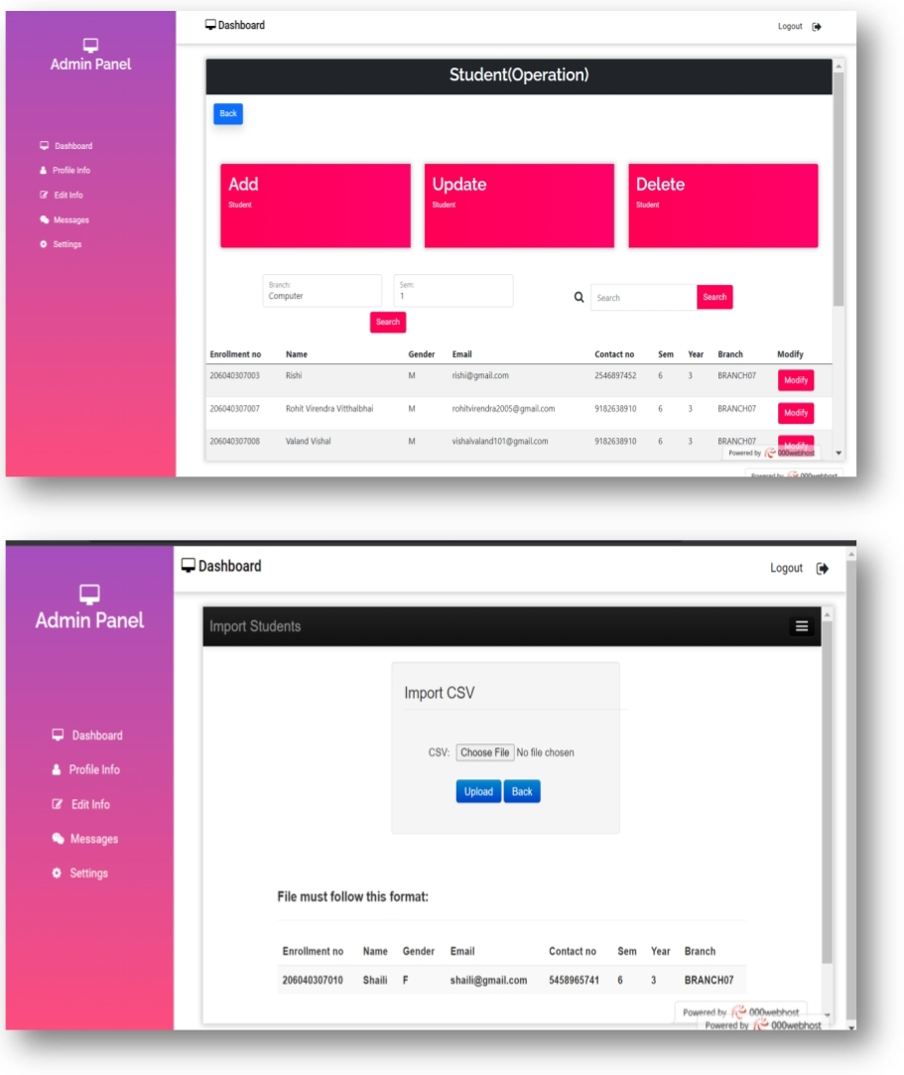

Slide 56
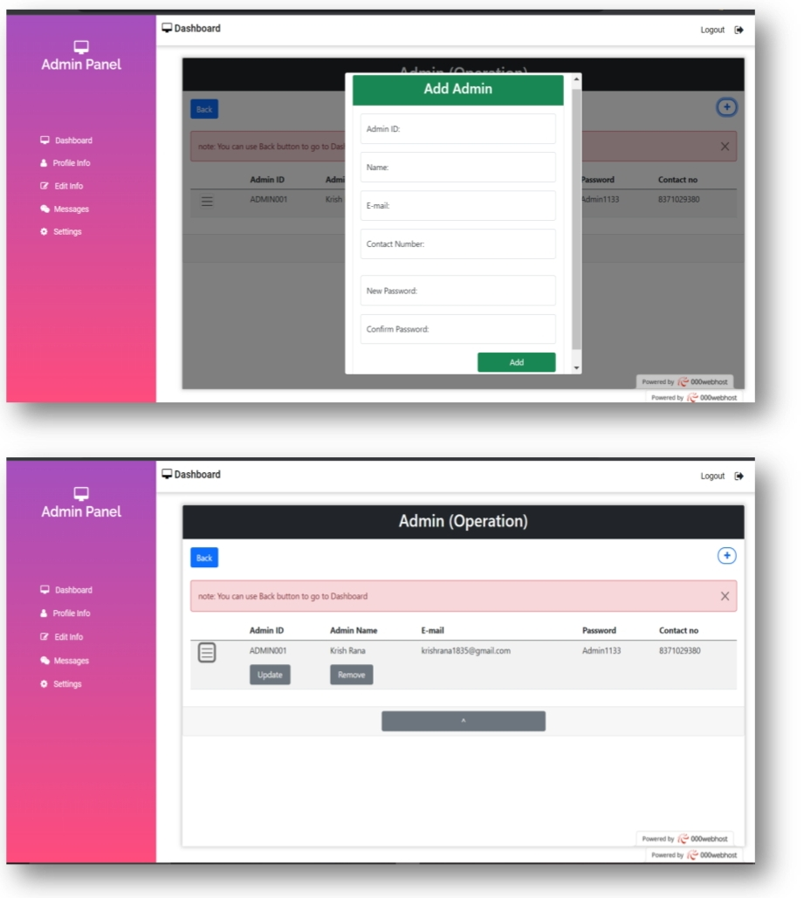

Slide 57
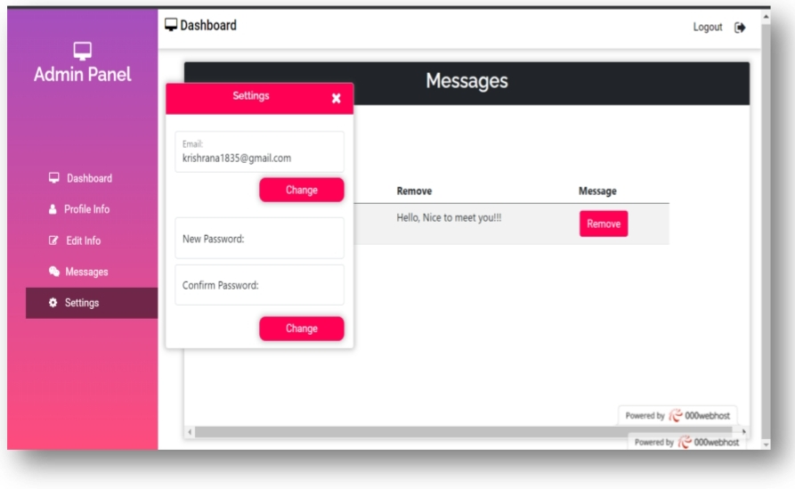

Slide 58
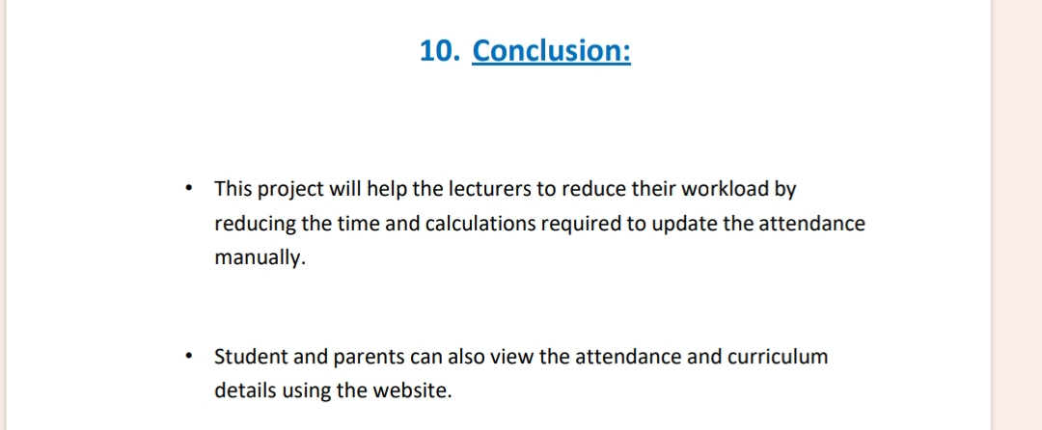

Slide 59
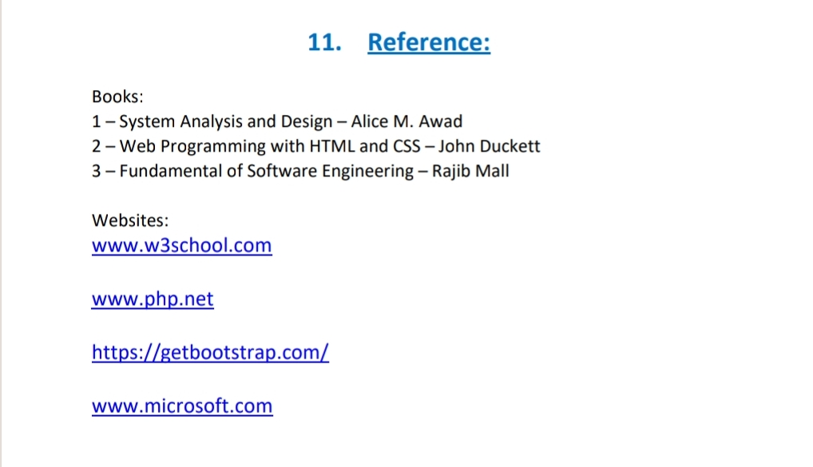

Slide 60
THANK YOU..!!

